Slide 1

EMPLOYEE MANAGEMENT SYSTEM
Project Supervisor: Mrs . B. Sandhiya (Ph.D.)
Name of the Student: Makineedi Sowmya Sri Lakshmi Bhavani
Register Number: 40110698

Slide 2
Presentation Outline
Introduction
Objectives
System Architecture / Ideation Map
Module Implementation
Application Snapshots
Results and Discussions
Conclusion & Future work
References

Slide 3
Introduction
Declarative:
This Employee Management System created based on python, Tkinter, and MYSQL Database. The Employee Management System is a small project for providing employee details of a company. Every organisation whether government or private uses an information system to store data of their staff. However, in India it is found that many small scale industries use pen and paper to keep a record.
This system will calculate the salary of them at the end of month. It also calculates overtime and total working hours of each employee. It saves lots of time and has no error in pay calculation hence preventing clashes between HR Team and employees. So that both employer and employee can focus on their work to develop their company.

Slide 4
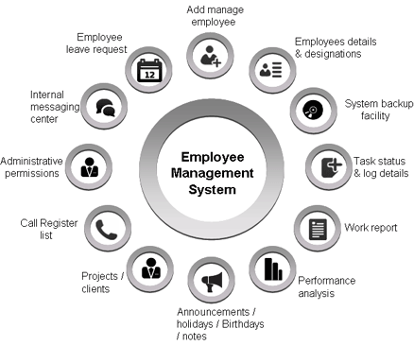
Objectives
Aim of the employee management system:
This GUI based Employee Management system provides the simplest management of employee details. In short, this projects mainly focus on save, delete, clear, update. There’s an external database connection file used in this mini project to save empoyee’s data permanently.

Slide 5
Objectives
Scope of the system to manage businesses:
An effective employee management system is used to manage the work process and organizational responsibilities of human resources and other departments. It helps managers and employees to work together and accurately monitor, access, manage, and efficiently utilize the working hours for better business growth .
To develop a system that will serve as the centralized database of employees.
Companies will be able to use the system as a source of data .
The system’s output will allow businesses to improve the quality of their services

Slide 6
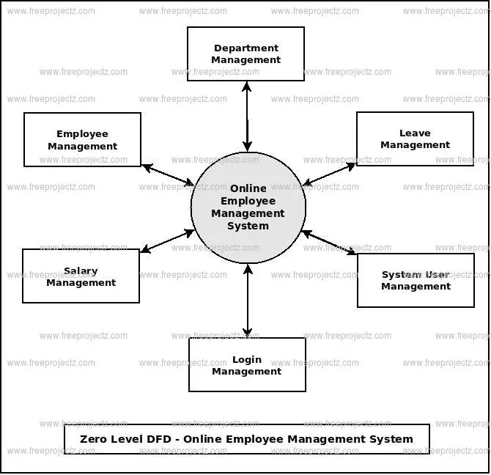
System Architecture/ Ideation Map
11 November 2021
Department of CSE

Slide 7
First we need to add employee details with there all necessary information
After entering all the information in the fields then we have to click the save button to save this details in database and there is a options to update and delete the employee details from the database
Then we can save in the database if we want to delete the employee from the database simply select what to delete then click delete button to the details from the database
11 November 2021
Department of CSE

Slide 8
Project Implementation
Importing required Libraries:
from tkinter import * import tkinter.ttk as ttk import tkinter.messagebox as tkMessageBox
from PIL import ImageTK
tkinter: Python Tkinter is the most preferred package used for creating nice GUIs for applications as it has a variety of methods like pack(), grid(), and place() for geometry management. It has standard attributed dimensions, fonts, colors, cursors, anchors, and bitmaps for better GUI. Moreover, it has a vast array of widgets to choose from and is by far the easiest to use. The combination of all these features makes Python Tkinter makes it very popular among Python developers and makes it a favorable tool to use.
Ttk and tkMessageBox: The ttk and tkMessageBox module is used to display message boxes in your applications. This module provides a number of functions that you can use to display an appropriate message.

Slide 9
Pillow (a fork of PIL):
Python Imaging Library (expansion of PIL) is the de facto image processing package for Python language. It incorporates lightweight image processing tools that aids in editing, creating and saving images. Support for Python Imaging Library got discontinued in 2011, but a project named pillow forked the original PIL project and added Python3.x support to it. Pillow was announced as a replacement for PIL for future usage. Pillow supports a large number of image file formats including BMP, PNG, JPEG, and TIFF. The library encourages adding support for newer formats in the library by creating new file decoders.
This module is not preloaded with Python. So to install it execute the following command in the command-line: pip install pillow

Slide 10
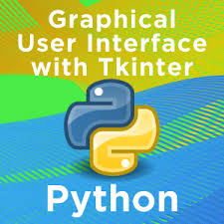
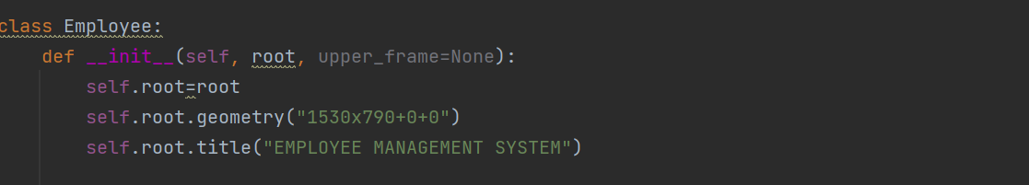
Creating user interface:
more of the above-mentioned widgets to the GUI application. Enter the main event loop to take action against each event triggered by the user.
Creating the Emplyee details interface. For adding the feedback details entering interface and updating details interface finally it saves database these all created using tkinter module
19 April 2023
Department of CSE
10

Slide 11
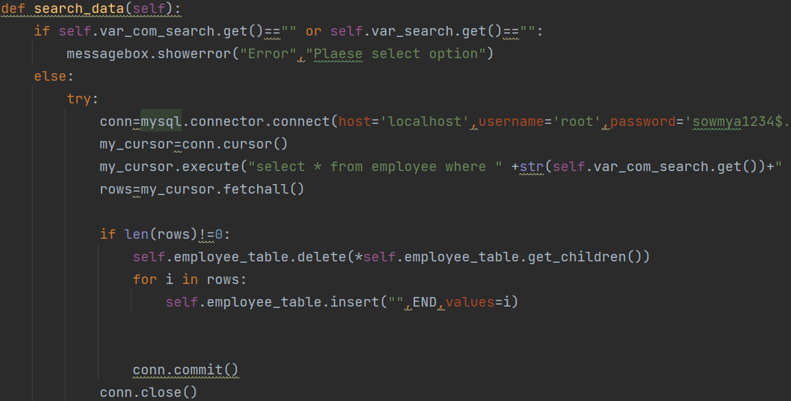
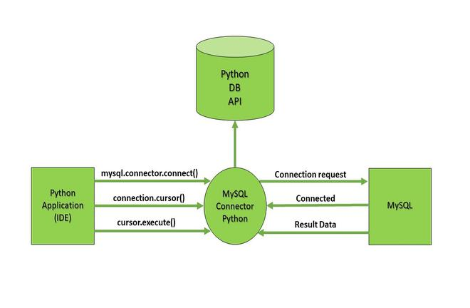
Data database connectivity:
Connect to MySQL Database in Python
Import MySQL connector package. Create a connection object using the connect() method by passing the name of the database as a parameter to it. The cursor() method returns a cursor object using which you can communicate with MySQL
First, connect to the MySQL database by creating a Connection object. Second, create a Cursor object by calling the cursor method of the Connection object. Third, execute an INSERT statement.

Slide 12
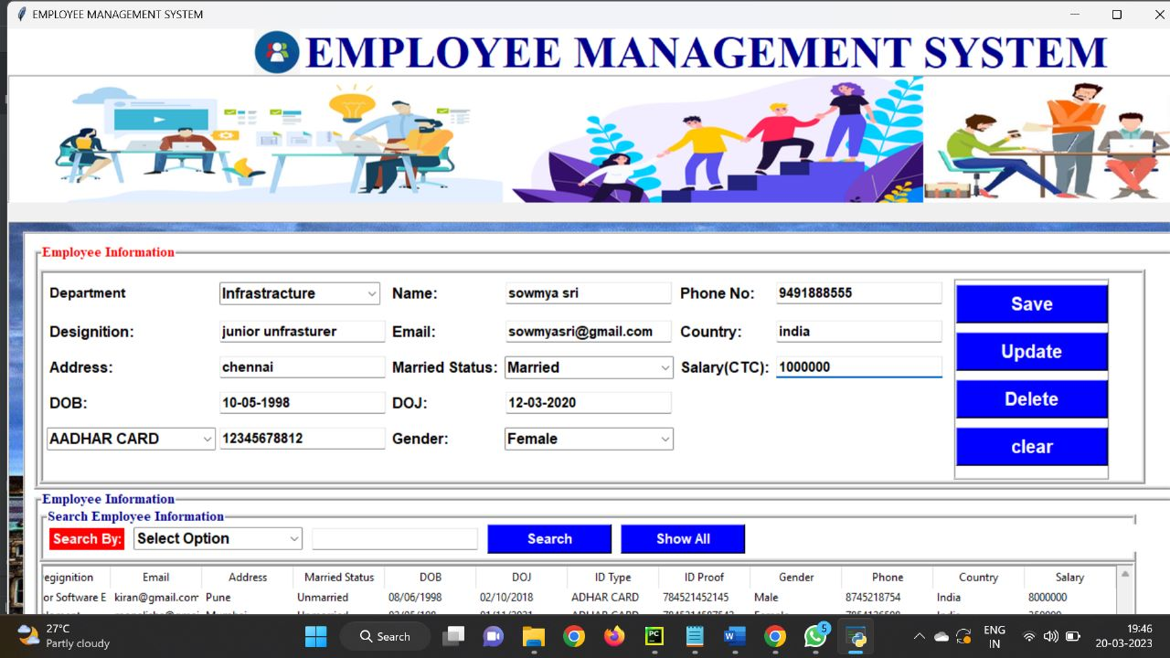
Sample Snapshot

Slide 13
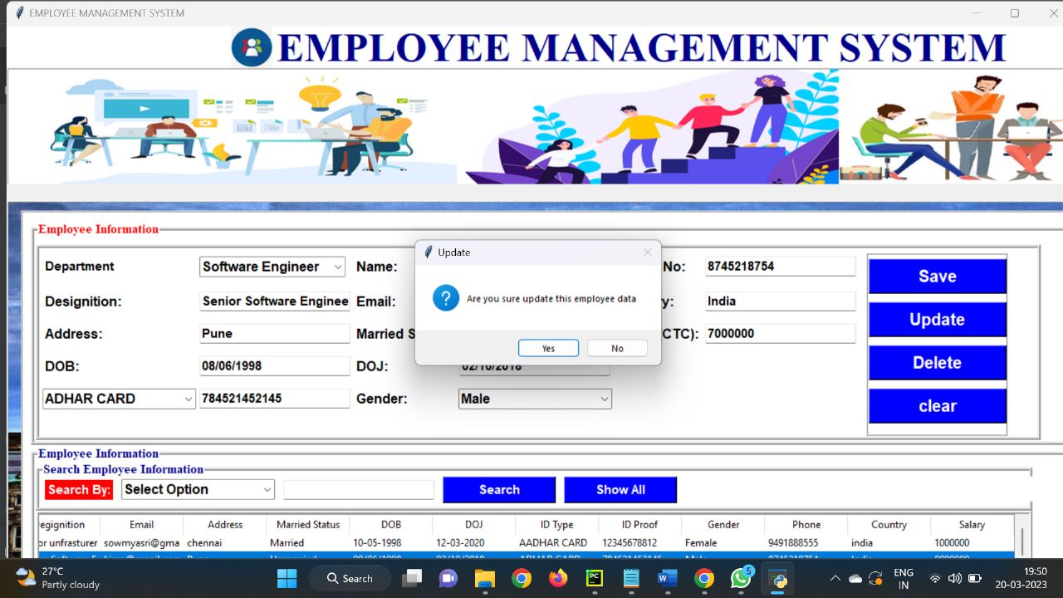
Sample Snapshot

Slide 14
Results and Discussion
Results
The Employee Management System Project In Python was developed using Python Programming, this project created using Graphical User Interface (GUI) and connected into database using MySQL
This EMS can help you improve team motivation and productivity . The tool lets you monitor, evaluate and provide workers with feedback on their performance. When employee receive timely feedback, it helps in improving the work culture.
Discussion
The Employee Management System Project In Python is a graphical user interface system written and designed in the Python programming language . is a simple design which allows you to insert all the necessary data like Name, dob, gender, age, salary Department and Designation.

Slide 15
Conclusion
Software for employee management systems helps your organization improve workforce productivity and boost overall well-being by tracking and monitoring the daily working activities of every employee. In conclusion of employee management system blog, DeskTrack is one of the best software for workforce management. It keeps track of every activity done by an employee during his working hours. As a result, if you are searching for the best employee productivity monitoring software then DeskTrack has some impressive features that can be the best fit for your organization.
Employee Management Tools are categorized into different parts. It is basically differentiated according to employees. If we talk about developers we need software that is able to calculate productivity, as well as if we are talking about some of the HR they consume more time in administrative work so we need an employee management system that is able to track the time of tasks..

Slide 16
References
Websites:
Tkinter
tkinter — Python interface to Tcl/Tk https://docs.python.org/3/library/tk.html
MySQL
https://dev.mysql.com/doc/
Books:
Mastering Visual Basic 6(Paperback)
Visual Basic Black Book(Paperback)
Databas Development in Visual Basic
Teach Yourself Visual Basic 6 McGraw Hill
Software Engineering-Robert A. Pressman(McGraw Hill)

Slide 17
THANK YOU

